Slide 1
Medicare 101: The Basics
(insert name), Regional Manager
(insert e-mail address)
(insert work cell phone number)

Slide 2
What is Medicare?

Slide 3
What is Medicare?
Federally-funded individual health insurance program that provides coverage for medically-necessary procedures, services, medical supplies and equipment

Slide 4
Who is Eligible?
Anyone age 65 or older who participates in Social Security or the
Railroad Retirement System
Employees of Federal, State or Local Governments, or those whose
spouse has participated
Individuals under age 65 who have been awarded Social Security or
Railroad Retirement Disability after 24 months
Those disabled due to ALS (Lou Gehrig’s Disease)
Individuals with End-Stage Renal Disease (ESRD)

Slide 5
Administration and Enrollment
Medicare is administered by the Centers for Medicare and
Medicaid Services (CMS)
CMS is a branch of the Department of Health and Human
Services (DHHS)
The Social Security Administration (SSA) is responsible for
Medicare eligibility and enrollment

Slide 6
Do I Need to Enroll into Medicare Part A and Part B (“Original Medicare”)?

Slide 7
Automatic Enrollment
If collecting Social Security Retirement Benefits prior to age 65
People under 65 who are entitled to Social Security Disability Benefits, when they have received 24 months of continuous payments:
Beneficiary will receive Original Medicare card (red/white/blue card) in the mail, indicating automatic enrollment in Part A and Part B
Beneficiary has the option to decline Part B coverage by returning the card to Social Security
Coverage will begin the first day of your birth month, unless your birthday is the first day of the month, in which case, coverage begins the first day of the preceding month

Slide 8
Initial Enrollment Period (IEP)
If turning 65 and not collecting Social Security Retirement benefits (Automatic
Enrollment)
Seven-month period to enroll into Original Medicare without penalty: three months
before, the month of, and three months after your 65th birth month
If you sign up for Part A and/or Part B during the first three months of your IEP, in most
cases, your coverage begins on the first day of your birthday month. (NOTE: If your
birthday is on the first day of the month, your Medicare coverage begins on the first
day of the prior month
NOTE: Beginning January 1, 2023, if you sign up the month you turn 65, or during the last three months of your Initial Enrollment Period, your Medicare coverage starts the first day of the month after you sign up

Slide 9
General Enrollment Period (GEP)
For those that who do not qualify for Automatic Enrollment, and who do not enroll during their Medicare IEP, there is another opportunity to enroll each year
Begins January 1st and ends March 31st
Enrollments during this period will have a delay in coverage, and a late-enrollment penalty (LEP) will apply
Beginning January 1, 2023, when you sign up during the General Enrollment Period, your Medicare coverage starts the first day of the month after you sign up
10% Part B premium penalty, for one’s lifetime, for each 12-month period without Part B coverage
LEP is waived when Part B is delayed, if there is primary Employer Group Health Plan (EGHP) coverage (NOTE: See “Special Enrollment Period” on next slide)

Slide 10
Special Enrollment Period (SEP)
A Medicare beneficiary may be able to delay enrolling in Medicare Part B
If they or their spouse are actively working, and the employer providing the Employer Group Health Plan (EGHP)
Has 20 or more employees (for a Medicare beneficiary aged 65 and older)
Has 100 or more employees (for a Medicare beneficiary younger than age 65)
Eight-month period begins when EGHP ends or stops being primary

Slide 11
How Do I Enroll in Medicare Part A and Part B?
Medicare entitlement and enrollment is handled by the Social Security Administration(SSA)
Can be completed online at www.ssa.gov
Call 1-800-772-1213 (Monday through Friday, 7AM to 7PM)
Appointments can also be made for local offices through the
toll-free number listed above

Slide 13
Your Medicare Coverage Choices (there are two options)

Slide 14
Your Medicare Coverage Choices

Slide 15
What Does Original Medicare Cover?
Medicare Part A
Medicare Part B
Inpatient Hospital Coverage
Skilled Nursing Care in a facility (requires a minimum three-day prior hospitalization)
Home Health Care
Hospice
Blood
Outpatient Hospital Coverage
Physician Services
Outpatient Surgery and Services
Durable Medical Equipment (DME), prosthetics, orthotics and supplies
Home Health Care
Preventative Services
Blood
Medicare benefits are administered by the Centers for Medicare and Medicaid Services (CMS)

Slide 16
What Is NOT Covered by Original Medicare?
Outpatient Prescription Medications
Routine Dental Care
Routine Vision Care and Eyeglasses
Hearing Aids
Foreign Travel
Cosmetic Procedures and Treatments
Long Term Care

Slide 17
Medicare Part A and Part B

Slide 19
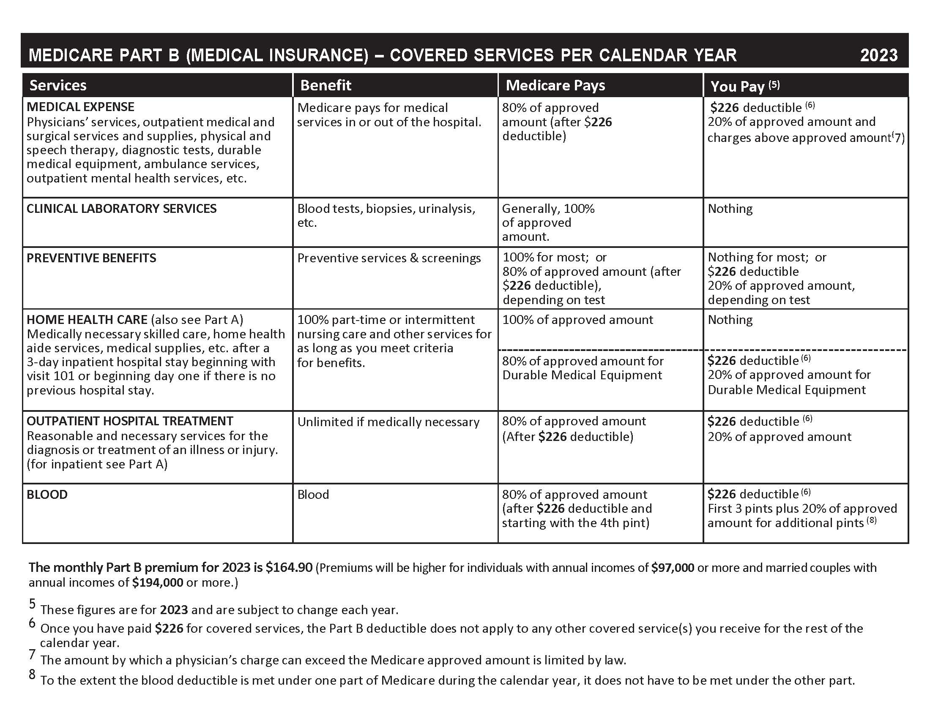

Slide 20
Medicare Supplement (Medigap Plans)
Nationally standardized insurance plans designed to fill in the “gaps” in
Medicare coverage (deductibles, copayments, coinsurance, etc.)
Plans are designated by letters (A, B, C, D, F, G, K, L, M, and N).
Plans C, F, and F-Prime are only available to individuals who were eligible for Medicare prior to January 1, 2020
All plans cover a basic group of benefits, with plans each covering a
different group of benefits
Coverage is the same from company to company, but premiums do vary
This presentation does not address how Medicare works with other
insurance coverage, such as EGHPs, COBRA, TriCare or VA benefits

Slide 21
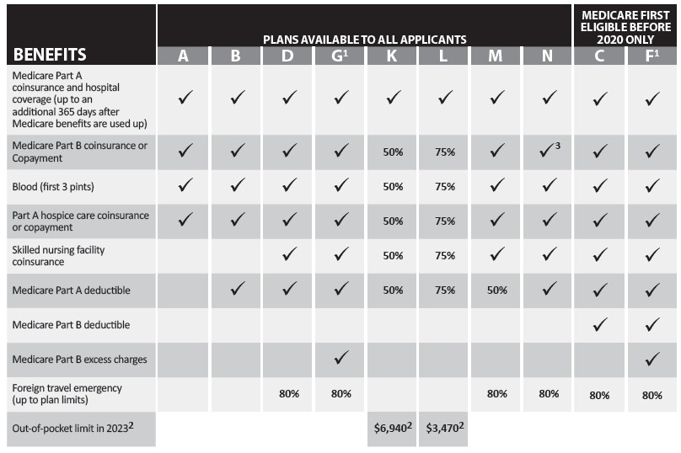

Slide 22
Medicare Prescription Drug Coverage – Part D
Anyone covered by Medicare Part A and/or Part B is eligible to
purchase a Medicare Prescription Drug (PDP)
PDPs are sold by private insurance companies that are contracted with
CMS, and require payment of monthly premiums
Each PDP covers a group of prescription medications (formulary).
Annual deductible may need to be satisfied
Copayments apply to prescription medications
Plans and formularies may change annually
Compare your Medicare PDP each year during the Medicare Open Enrollment Period (OEP)

Slide 23
When Can I Enroll into a Part D Plan?
During your seven-month Initial Enrollment Period (IEP)
During the annual Medicare Open Enrollment Period (OEP)
October 15th through December 7th each year
Coverage begins on January 1st
May be able to join at other times
Annual Medicare Advantage Open Enrollment Period (MAOEP)
January 1st through March 31st each year
Special Enrollment Period (SEP)
You must qualify for an SEP (i.e., qualifying for Extra Help, move outside of the Plan’s service, etc.)

Slide 24
Part D Extra Help Program
Assistance is available for people with limited income and resources/assets
Eligibility is determined by the Social Security Administration
Can reduce or eliminate monthly premiums, reduce prescription drug
copayments, and provide a quarterly SEP to make a change to another
Plan
Quarterly changes are available only during the first three quarters of the calendar year:
January 1st through March 31st
April 1st through June 30th
July 1st through September 30th

Slide 25
Your Medicare Coverage Choices

Slide 26
Medicare Advantage (MA) Plans - Part C
Health Plan options approved by Medicare
Another way to get your Medicare coverage
Still part of the Medicare Program
Offered by private companies who are contracted with CMS
Medicare pays the Plan an amount for each member’s care
May have to use network healthcare providers (doctors, hospitals etc.) ALWAYS check with your healthcare providers regarding “Plan contracting”
Plans’ availability varies from county to county
There is an additional opportunity to change Medicare Advantage Plans each year
January 1st through March 31st (MAOEP)

Slide 27
When and How Can You Enroll into a Medicare Advantage Plan?
During your Initial Enrollment Period (IEP)
During the annual Medicare Open Enrollment Period (OEP)
October 15th through December 7th each year
During the Medicare Advantage Open Enrollment Period (MAOEP)
January 1st through March 31st each year
Based on a Special Enrollment Period (SEP), but you must qualify
(For example, moving to a different county or state, or qualifying for Extra Help, etc.)

Slide 28
Original Medicare vs. Medicare Advantage Plans

Slide 29
Differences between Medigap Plans and Medicare Advantage Plans

Slide 30
Medicaid and Medicare Savings Programs
Assistance is available for people with limited incomes and resources/assets
Eligibility is determined by the county Department of Social Services (DSS) in
which the person resides
In addition to full Medicaid, there are three Medicare Savings Programs (MSPs)
with different levels of assistance, for those who are eligible for Medicare: QMB,
SLMB, and QI-1
For the Medicare Savings Programs, income determines the level of assistance
Assets/resource limits are the same for all three levels
Can reduce or eliminate monthly Part A and Part B premiums, deductibles, and
coinsurance amounts
Automatic eligibility for Extra Help for any level of Medicaid or MSP

Slide 31
Does Medicare Cover Preventive Care?

Slide 32
Inflation Reduction Act (IRA) and Medicare
These provisions will be phased in over a seven-year period, beginning in 2023, and will be fully phased in in 2029

Slide 33
Inflation Reduction Act (IRA) and Medicare (effective 2023)
• Manufacturers of certain Part D drugs will be required to reimburse or rebate
Medicare if the price of that drug increases faster than the rate of Urban Consumer
Price Index (UCPI) inflation. Financial penalties would be levied for non-compliance
• Caps on insulin costs: Monthly out-of-pocket cost sharing for insulin would be capped
at $35.00, per prescription. This applies to insulin covered by both Medicare Part D
and Part B. The Part D provision will be effective January 1, 2023, and the Medicare
Part B provision will be effective July 1, 2023
• Eliminates cost sharing for adult vaccines covered under Medicare Part D that are
recommended by the Advisory Committee on Immunization Practices (ACIP). The
vaccine must be on the Part C or Part D Plan’s formulary in order to be covered

Slide 34
NC Senior Medicare Patrol (NCSMP) Program
The goal of the NCSMP program is to empower all Medicare beneficiaries to prevent health care fraud, waste and abuse through education and outreach. NCSMP Counselors are comprised of retired professionals, senior citizens and partnering human service agencies staff. Their mission is to provide education about Medicare error(s), fraud, waste and abuse.
All SHIIP Counselors are cross trained to be NCSMP Counselors. Their goal is to educate beneficiaries within their communities to PROTECT, DETECT and REPORT Medicare fraud, waste and abuse.

Slide 35
NC Senior Medicare Patrol (NCSMP) Program
$68 billion is lost each year to Medicare fraud nationally
PROTECT yourself against Medicare fraud
DETECT potential Medicare fraud, errors and abuse
REPORT suspected Medicare fraud, errors and abuse
to NCSMP at 855-408-1212

Slide 36
Medicare.gov
When you visit Medicare.gov, you will be able to:
Find information about Medicare health and drug Plans in your area,
including the costs related and the services provided
Find Medicare-participating doctors and/or other healthcare providers and suppliers
See the benefits and services covered by Medicare, including preventive services
Find Medicare Appeals information and forms
Find information about the quality of care provided by Plans, nursing homes,
hospitals, doctors, home health agencies, dialysis facilities, hospice providers,
inpatient rehabilitation facilities and long-term care hospitals
Find additional resources, including important and helpful websites and phone
numbers

Slide 37
Medicare.gov Account
If you create a Medicare.gov account, you will be able to:
Add prescriptions and pharmacies to help you better compare health and
drug Plans in your area
Sign up to go paperless – receive your yearly “Medicare and You” handbook
and Medicare Summary Notices (MSNs) electronically
View your Original Medicare (Part A and Part B) claims as soon as they are
processed
Print a copy of your Original Medicare card
See a calendar of preventive services that you are eligible to receive under
Original Medicare (Part B)
Learn about your Medicare premiums and pay them online if you receive a
statement

Slide 38
Interested in Becoming a SHIIP Volunteer?
Contact your county’s SHIIP Coordinating Site

Slide 39
Where Can You Get Help?
Seniors’ Health Insurance Information Program (SHIIP) and
North Carolina Senior Medicare Patrol (NCSMP)
855-408-1212 (toll free) Monday through Friday, 8 AM until 5 PM
www.ncshiip.com
Medicare
800-633-4227 (nationwide, toll free) 24 hours/day, 7 days/week
www.medicare.gov
Social Security Administration
800-772-1213 (nationwide, toll free) Monday through Friday, 8 AM until 7 PM
www.ssa.gov

Slide 40
Where Can You Get Help?
“Medicare and You” Handbook
Remember, this is the owner’s manual for people on Medicare!

Slide 41
Questions?
Contact SHIIP and NCSMP
855-408-1212
(Monday through Friday, 8:00 AM to 5:00 PM)
www.ncshiip.com
ncshiip@ncdoi.gov

